Slide 1

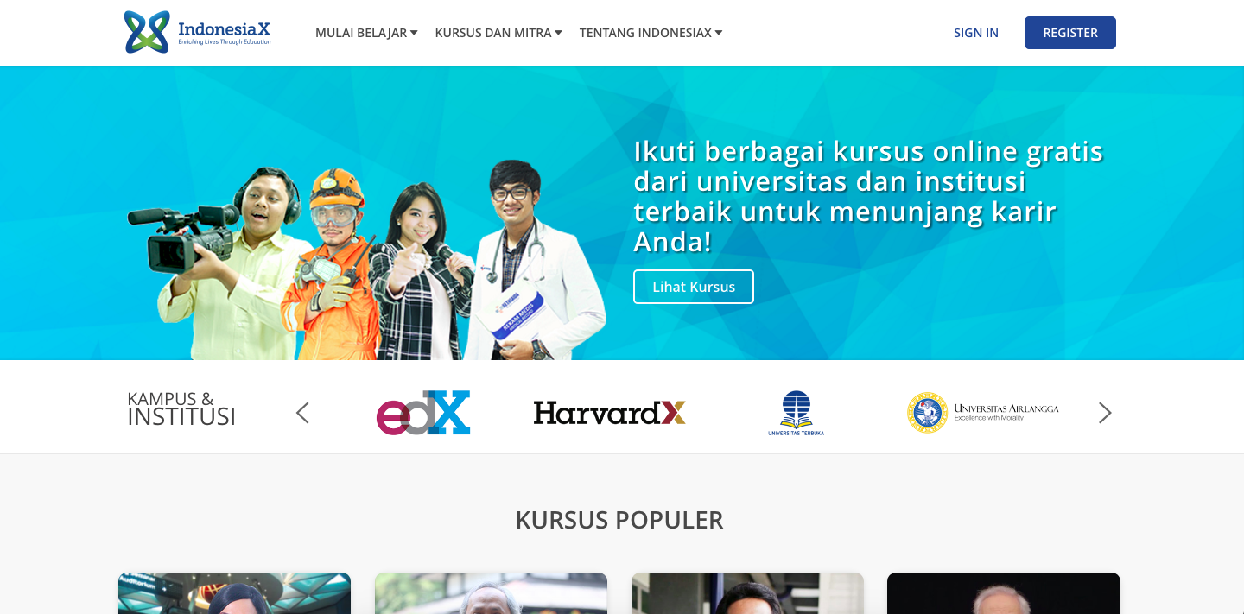
WWW.INDONESIAX.CO.ID
1

Slide 2
VISION AND MISSION
Vision
To be the most preferred independent online MOOC/SPOC hosting platform which enriches lives of Indonesians.
Mission
To provide a state-of-the-art, sustainable, and affordable online MOOC/SPOC hosting platform that offers free high quality online MOOCs/SPOCs provided by the best local and foreign universities, government agencies, companies and other respected institutions.
To help democratize education and improve life-skills of Indonesians spread out in Indonesian archipelago
2

Slide 3
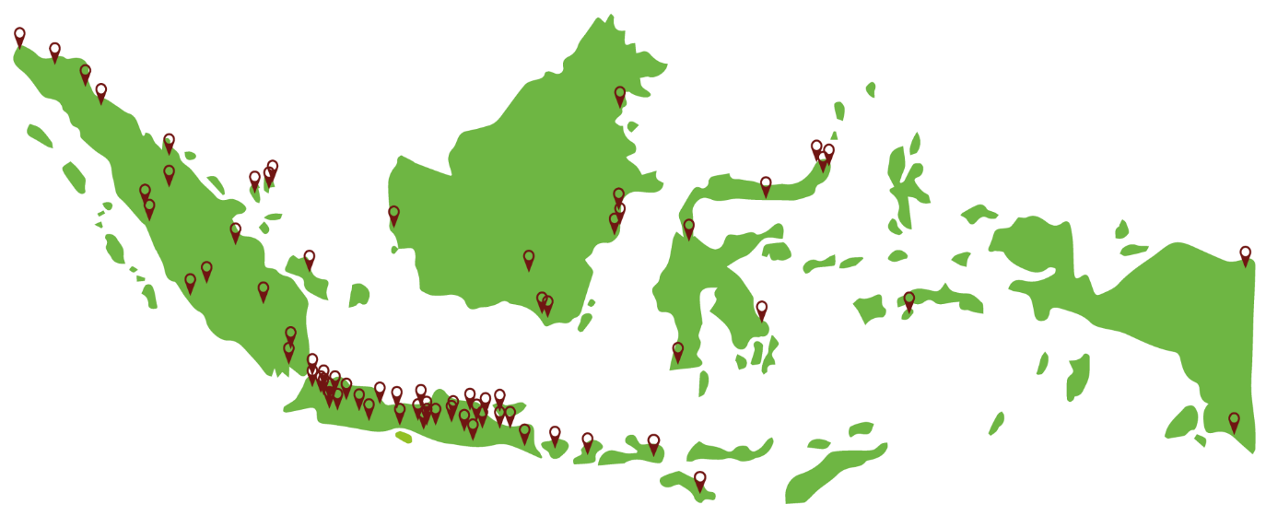
WHERE WE ARE NOW - INDONESIA
as per Nov 25, 2016
Top 5 Provinces
1. West Java 23,1%
2. DKI Jakarta 17,2%
3. East Java 13,8%
4. Banten 7,6%
5. Central Java 7,0%
Learners from Java 68,7% Learners from other 31,3%
provinces in Indonesia
Our learners are spread out in all 34 provinces and 563 cities in Indonesia
3

Slide 4
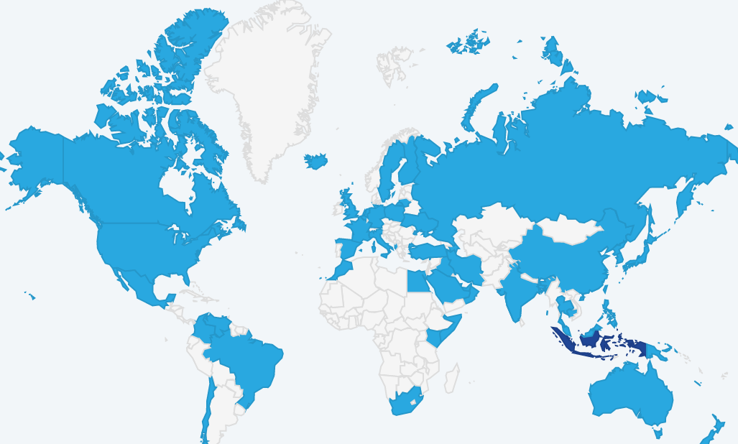
GLOBAL REACH
as per Nov 25, 2016
# Countries
65
# Course Registrants
85.018
# Cities
792
# of Page Views
4.914.940
4

Slide 5
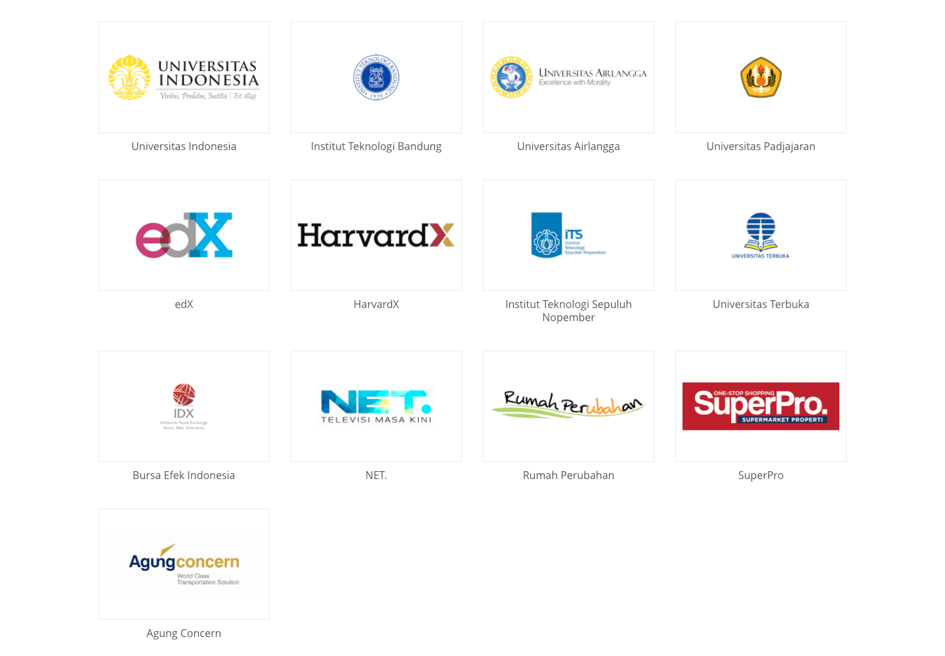
OUR PARTNERS
5

Slide 6
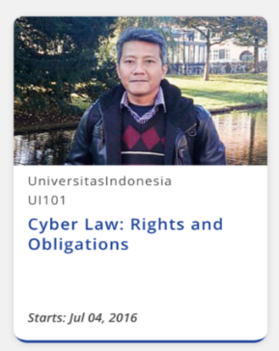

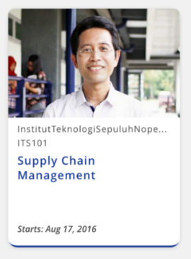
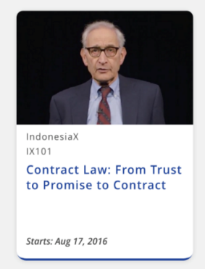
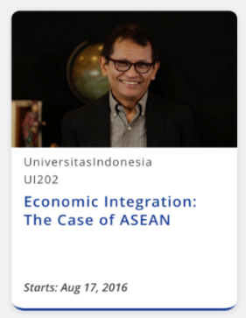
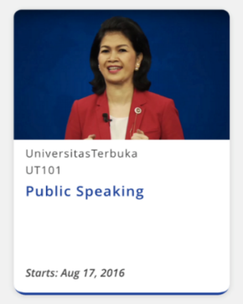

OUR COURSES - ACADEMIC
We aim for 30% Academic and 70% Life Skills
6

Slide 7
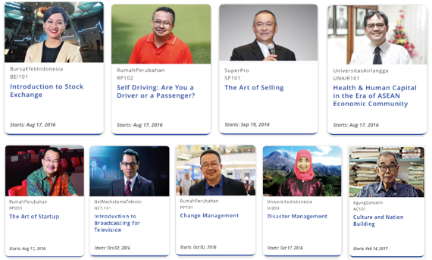
OUR COURSES – LIFE SKILLS
7

Slide 8
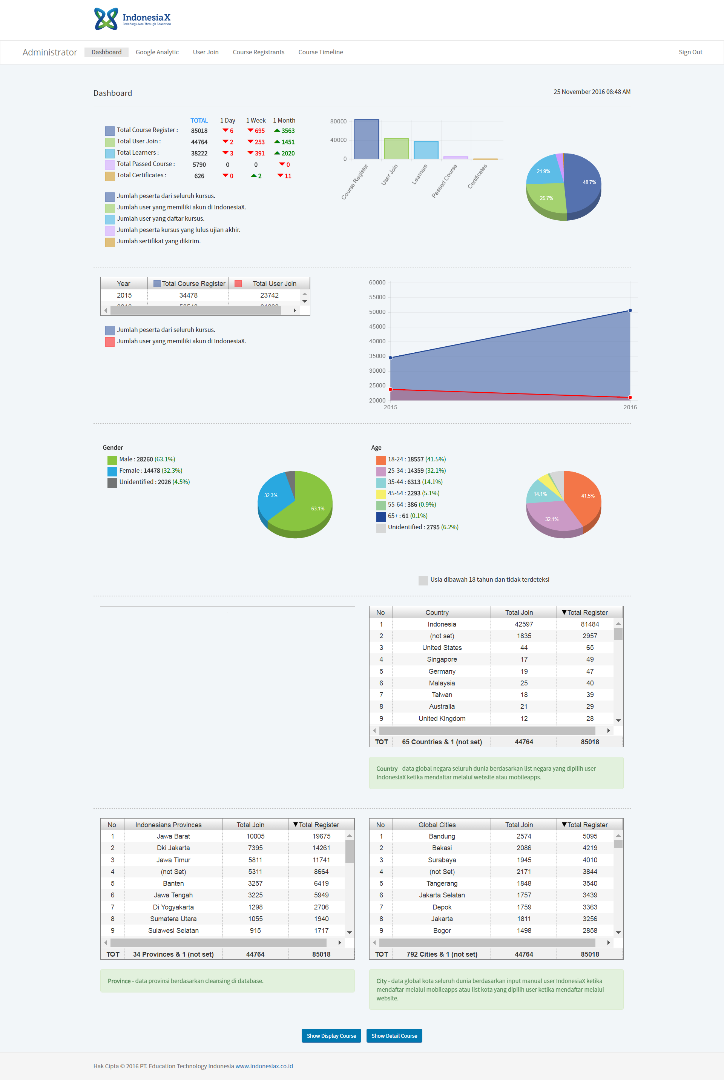
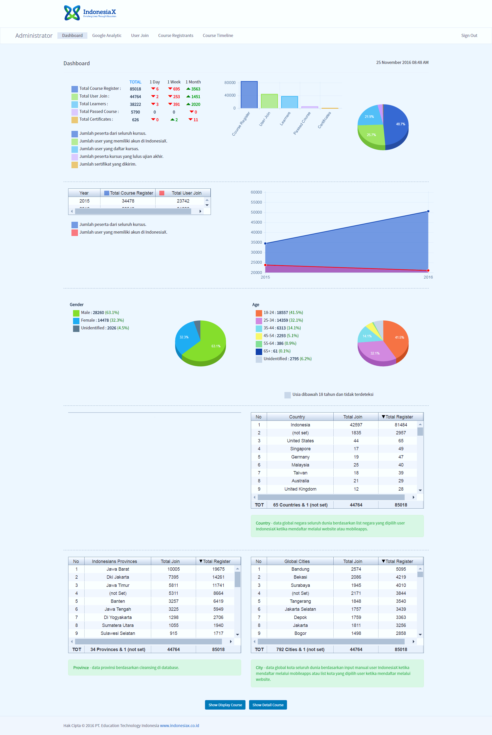
OUR LEARNERS
as per Nov 25, 2016
Ratio (certificates to registrants) | 2015 | 2016
 | 0.26% | 0.74%
Most learners are from 18-24 and 25-34 age bracket
More male learners than female ones
Ratio of certificates vs registrants is on increasing trend
8

Slide 9
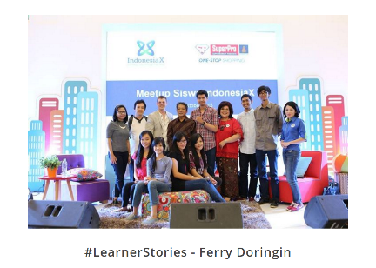
LESSONS LEARNED
Positive response from students
Positive response from universities
(both on MOOC existence as well
as in providing content)
Positive response from corporates (in providing content and in
using the courses as training material)
Positive responses from government
Poor internet connection in provinces in East Indonesia and in some West too
Difficulty in getting funding
9

Slide 10
GOING FORWARD
Reach more cities/towns in Indonesia
Cooperation with telco companies and broadcast media to reach wider area coverage
Involvement of Provincial Governments in reaching learners
Collaboration with Government Agencies and NGO
More MOOCS from companies/industries (HC requirement)
Training platform for corporates
Curriculum Development
More MOOCs from foreign universities on latest development
English translation
Accreditation
Sustainability (business model)
10

